Slide 1
Chest X-Ray Pneumonia Classification
A basic machine-learning study
Handcrafted image features • Transparent baseline models
Project Presentation
01
Notes:
Introduce the study: a Phase 1 classical machine-learning project that classifies the dataset annotations from chest X-rays. This work is educational and is not a diagnostic system.

Slide 2
Problem & motivation
Target: the image-level NORMAL / PNEUMONIA annotation.
Challenge: class imbalance, acquisition variation and uncertain patient grouping.
Goal: compare simple models under one controlled evaluation protocol.
Question: how well do handcrafted image summaries classify held-out images?
Labels are dataset annotations, not independently confirmed diagnoses.
02
Notes:
The task is binary image classification: predict the dataset label NORMAL or PNEUMONIA. This project asks whether compact regional intensity features can separate these labels. It compares classical models and examines both missed pneumonia and false alarms.

Slide 3
Background & scope
Medical-image classification provides the task context.
Logistic regression and Naive Bayes make contrasting modeling assumptions.
Published deep-learning results are not directly comparable to this experiment.
No external hospital cohort or clinical-use claim is included.
Sources: Kermany et al. (2018); Ng & Jordan (2001); Zech et al. (2018).
03
Notes:
Prior work motivates image-based classification, a comparison between generative and discriminative models, and caution about site-specific shortcuts. This project is deliberately smaller: it tests basic features and explicit classical models on one audited internal split. Sources: Kermany et al., Cell (2018), https://doi.org/10.1016/j.cell.2018.02.010; Ng & Jordan, NeurIPS (2001); Zech et al., PLOS Medicine (2018), https://doi.org/10.1371/journal.pmed.1002683.

Slide 4
Dataset & experiment scope
Original split | NORMAL | PNEUMONIA | Total
Training | 1,341 | 3,875 | 5,216
Validation | 8 | 8 | 16
Test | 234 | 390 | 624
All images | 1,583 | 4,273 | 5,856
Audited set: 4,753 development images + 618 test images.
457 proxy-overlap exclusions; 28 duplicate exclusions.
Development: 1,348 NORMAL / 3,405 PNEUMONIA • Test: 231 / 387
04
Notes:
Counts come from the canonical image tree. The supplied validation folder contains only 16 images, so it joins development. The final test is held aside after removing proxy-linked and duplicate images.

Slide 5
Data audit & workflow
Check readable images, labels, exact duplicates and proxy-group overlap.
Keep test-linked development groups out; remove additional duplicates.
Explore images, extract fixed features and compare four model candidates.
Use grouped folds for selection, refit on development, then test once.
No test outcome is used to pick features, model, regularization or threshold.
05
Notes:
A random image split can place repeated images or apparent patient groups on both sides and inflate performance. Filename-based groups and exact pixel hashes are imperfect proxies, not verified patient IDs.

Slide 6
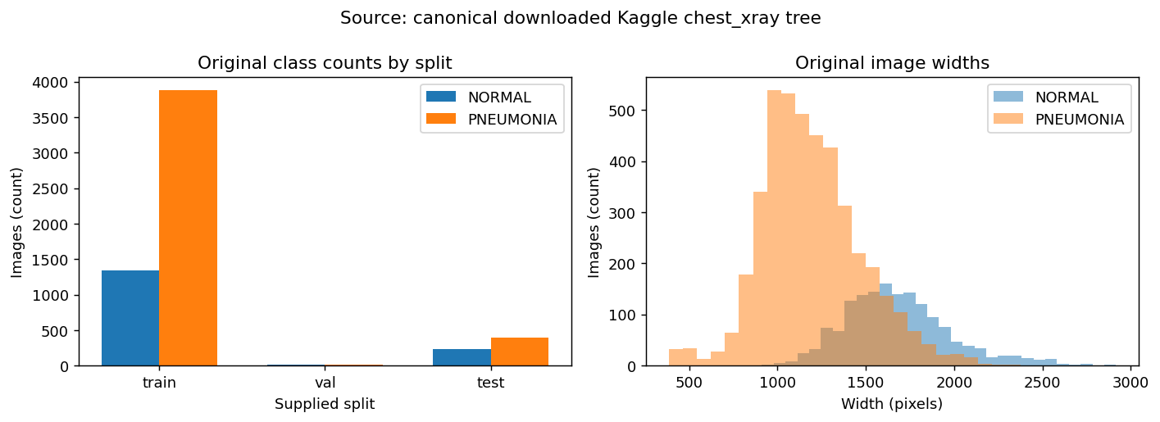
EDA: image sizes & class balance
Clinical age, sex, site and verified patient metadata are unavailable.
06
Notes:
The original data contain substantially more PNEUMONIA than NORMAL images. Accuracy alone can therefore conceal weak performance on the smaller class. Image dimensions also vary, so the feature pipeline uses a fixed shape.

Slide 7
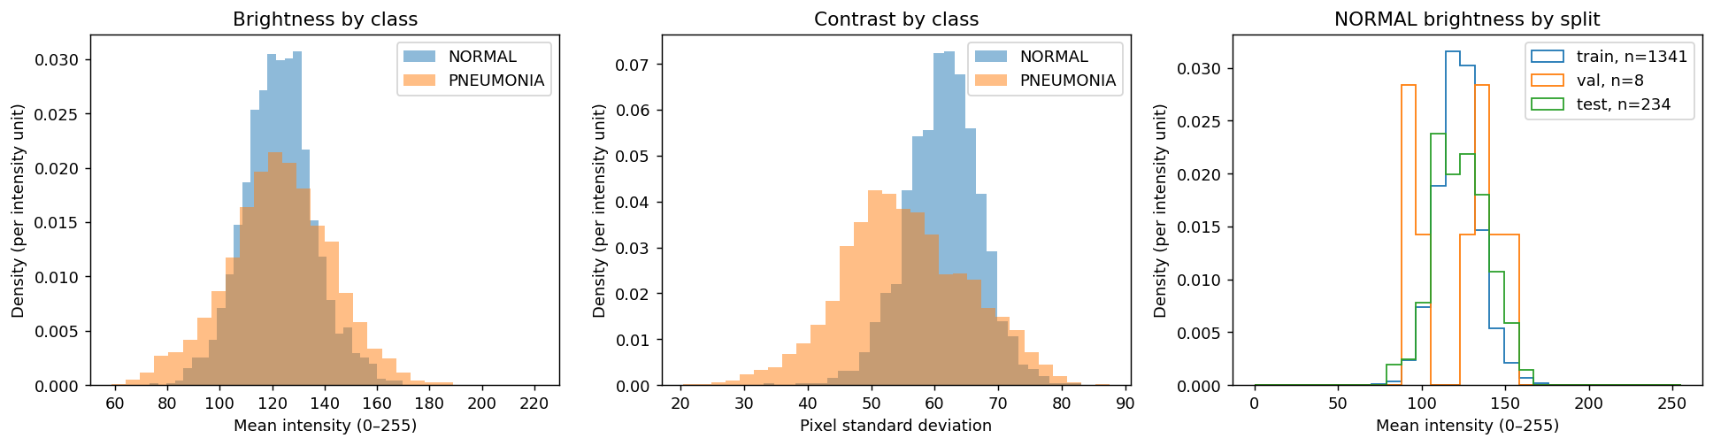
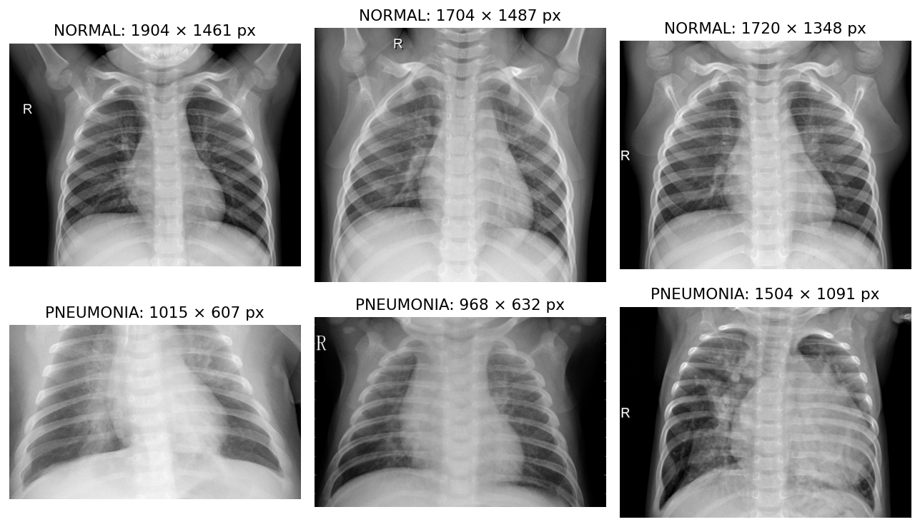
EDA: brightness, contrast & examples
Image labels come from the dataset; visual inspection does not independently verify them.
07
Notes:
Brightness and contrast differences can reflect acquisition conditions as well as anatomy. Representative images help explain the input type; their appearance is not used to assign new labels or explain individual model errors.

Slide 8
Feature engineering: 149 values per image
64 block means + 64 block standard deviations
+ 16 histogram proportions + 5 global summaries
Regional summaries preserve coarse location and local variation.
Histograms capture intensity distribution; global values summarize brightness and contrast.
Raw pixels, HOG/LBP, PCA or CNN features are alternatives with different detail, complexity and interpretability.
These summaries can discard subtle features or retain padding/acquisition shortcuts.
08
Notes:
Each image is converted to grayscale, resized with aspect ratio preserved, padded to 64 × 64, then divided by 255. An 8 × 8 grid gives local summaries while histogram and global values summarize overall intensity.

Slide 9
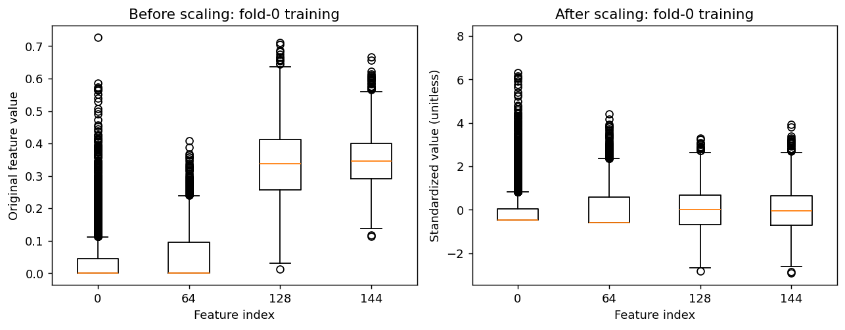
Feature scaling: standardization
z = (x − μ_train) / σ_train
Pixels are first divided by 255; standardization then scales each feature using training statistics.
Why: unlike-scales features can dominate gradient descent and L2 regularization.
Fit means and standard deviations on the current training fold only; reuse for validation.
No scaling leaves unequal influence; min–max scaling is sensitive to extremes; tree models usually need no scaling.
Scaling the full dataset before splitting would leak validation/test information.
09
Notes:
For each feature, the scaler computes z = (x − training mean) / training standard deviation. A constant column uses divisor 1 to avoid division by zero. Division by 255 is fixed pixel normalization; this standardization is learned from training rows. During each fold, fit only on fold-training images and apply unchanged to validation. Refit on all development images before final test.

Slide 10
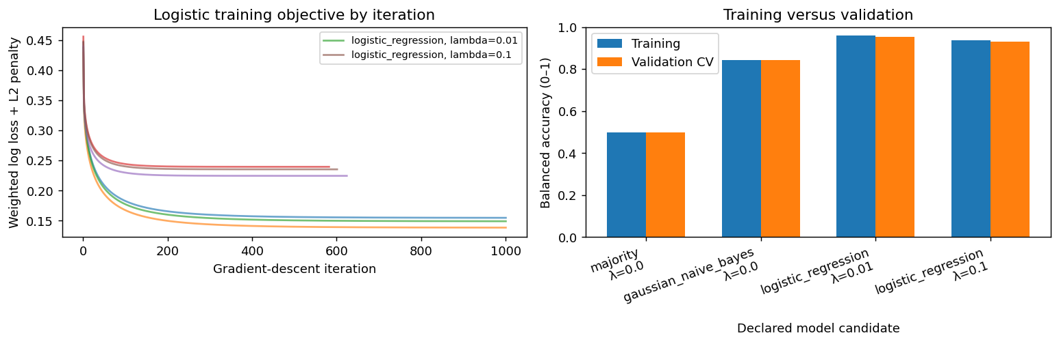
Validation design & leakage control
Fixed settings: seed 42; logistic λ ∈ {0.01, 0.1}; threshold 0.5.
Choose by mean balanced accuracy; then refit the selected model on all development rows.
Nested CV would reduce selection bias; the reported CV scores are for selection, not an unbiased final estimate.
10
Notes:
The tiny validation folder joins development. Three approximate stratified group folds keep each filename/hash proxy group in one fold. Each model fit learns its scaler and class weights from that fold’s training rows only.

Slide 11
Model design: simple, complementary candidates
Majority baseline: transparent reference; balanced accuracy is 50%.
Gaussian NB: fast, closed-form generative model; correlated features weaken its independence assumption.
Logistic regression: discriminative linear classifier with regularization; interpretable objective and explicit gradient descent.
Alternatives include raw-pixel models, richer texture features, trees or CNNs; these exceed the compact Phase 1 scope.
Scores are model outputs, not calibrated clinical probabilities.
11
Notes:
The majority baseline checks whether a model beats the trivial class prediction. Gaussian Naive Bayes uses per-class feature means and variances with conditional independence. Logistic regression estimates a linear boundary by minimizing class-weighted log loss plus an L2 penalty. The notebook implements sigmoid probabilities, weighted loss, analytical gradients, L2 on coefficients (not bias), full-batch gradient descent and backtracking.

Slide 12
Development results: logistic regression leads
Mean CV balanced accuracy (%)
Selected: logistic regression, λ = 0.01. Mean CV balanced accuracy: 95.38%.
12
Notes:
All candidates use identical group folds. Mean balanced accuracy is the selection measure. Logistic regression with λ = 0.01 wins; three folds and selection on the same CV results may make the best score optimistic.

Slide 13
Held-out test: confusion matrix & metrics
Actual / predicted | NORMAL | PNEUMONIA
NORMAL | 142 | 89
PNEUMONIA | 13 | 374
83.50% accuracy
79.06% balanced accuracy
96.64% recall
61.47% specificity
Precision 80.78% F1 0.8800
13
Notes:
The positive class is PNEUMONIA. At the predeclared threshold of 0.5 there are 13 false negatives and 89 false positives. Recall is high, while specificity is lower; showing both prevents the class imbalance from hiding normal-image errors.

Slide 14
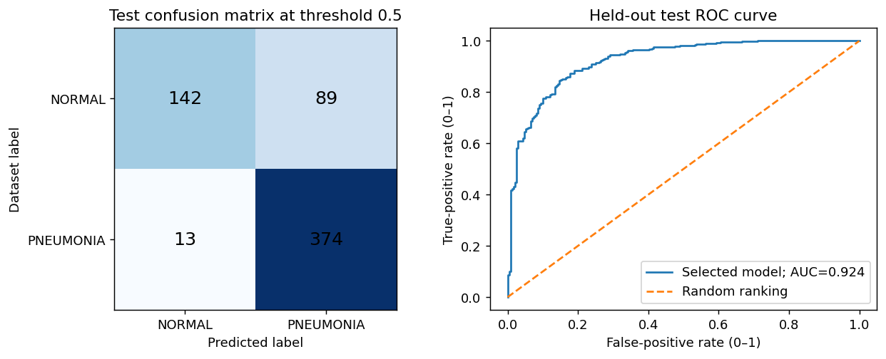
ROC curve & error analysis
AUC does not choose the threshold; false positives and false negatives remain consequential.
14
Notes:
The ROC curve plots true-positive rate against false-positive rate across score thresholds. AUC = 0.924 summarizes ranking ability, not a clinically appropriate operating threshold. The fixed threshold confusion matrix shows the chosen operating point; a small set of errors is inspected without retuning.

Slide 15
Feature ablation: spatial summaries add value
Mean CV balanced accuracy (%)
+7.25
percentage
points
CV balanced accuracy; same model setting and folds.
15
Notes:
Using the same development folds and λ = 0.01, compare the full 149-feature set with the 21 histogram/global features only. The difference estimates the contribution of spatial summaries within this development protocol; it is not independent test evidence.

Slide 16
Uncertainty & current limitations
Test balanced accuracy 95% interval: 75.71%–82.39%.
Test recall 95% interval: 94.67%–98.26%.
No verified patient identifiers or external-hospital evaluation.
Image acquisition, padding and coarse features may create shortcuts.
Educational benchmark only; no clinical deployment claim.
16
Notes:
Grouped bootstrap resamples test proxy groups 500 times. The intervals condition on one fitted model and imperfect groups; they exclude training and model-selection uncertainty. The 16.32-point CV-to-test balanced-accuracy gap and modest specificity call for caution.

Slide 17
Reproducibility & next steps
Notebook records split counts, settings, predictions, model parameters and plots.
Implementation checks cover gradients, ROC edge cases, group isolation and model reload.
Next: verified patient/site splits, external validation, threshold calibration and richer features.
Reference context: Kermany et al. (2018); Ng & Jordan (2001); Zech et al. (2018).
Python standard library + NumPy, Pillow, Matplotlib and Colab/IPython display.
17
Notes:
One Colab notebook runs on CPU with NumPy for arithmetic, Pillow for JPEG decoding and Matplotlib for figures. The classifier, feature extraction, standardization, gradient descent, validation and metrics are explicitly implemented rather than delegated to an ML estimator.

Slide 18
Key takeaways
A transparent baseline
with clear limits
Best development model
Held-out test recall
Next step
Logistic regression, λ = 0.01
96.64%
Verified patient splits
and external validation
Thank you
18
Notes:
This run supports logistic regression as the strongest of the compared Phase 1 candidates on development folds. Its held-out pneumonia recall is high, but 89 of 231 NORMAL images are false positives. Feature scaling and group-aware validation reduce avoidable leakage; external validation remains essential.

